Slide 2
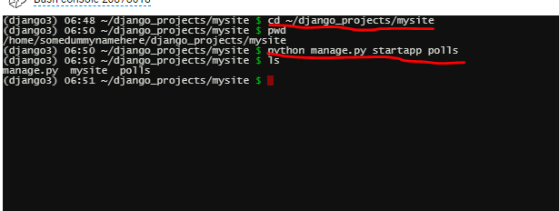
Make polls application
cd ~/django_projects/mysite
workon django3
python manage.py startapp polls
Notes:
It will create a new polls folder(bunch of sub directory under polls folder) under mysite directory

Slide 3
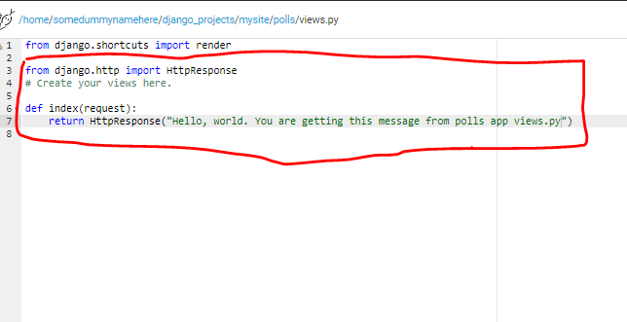
Edit views.py
Go to polls/views.py and put some contents in

Slide 4
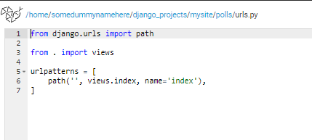
Edit urls.py
Create urls.py under polls
Include the following code:

Slide 5
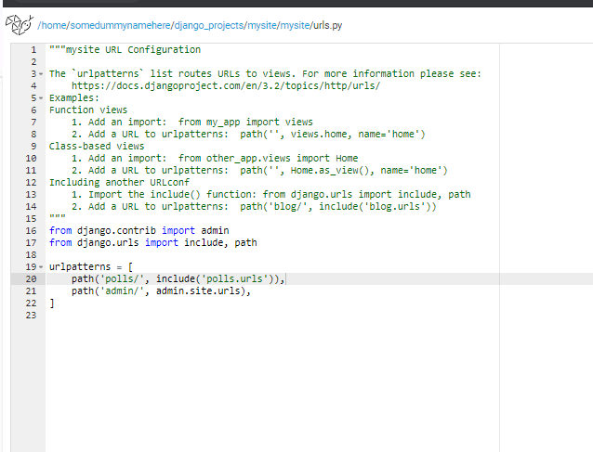
Update mysite/mysite/urls.py

Slide 6
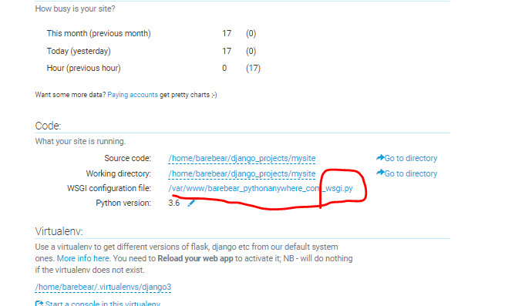
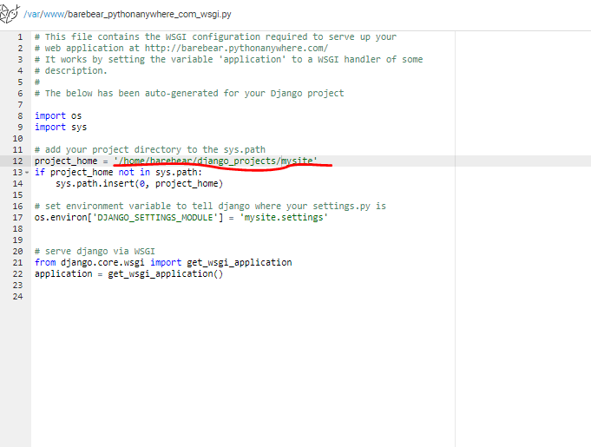
Upadate WSGI.py

Slide 7
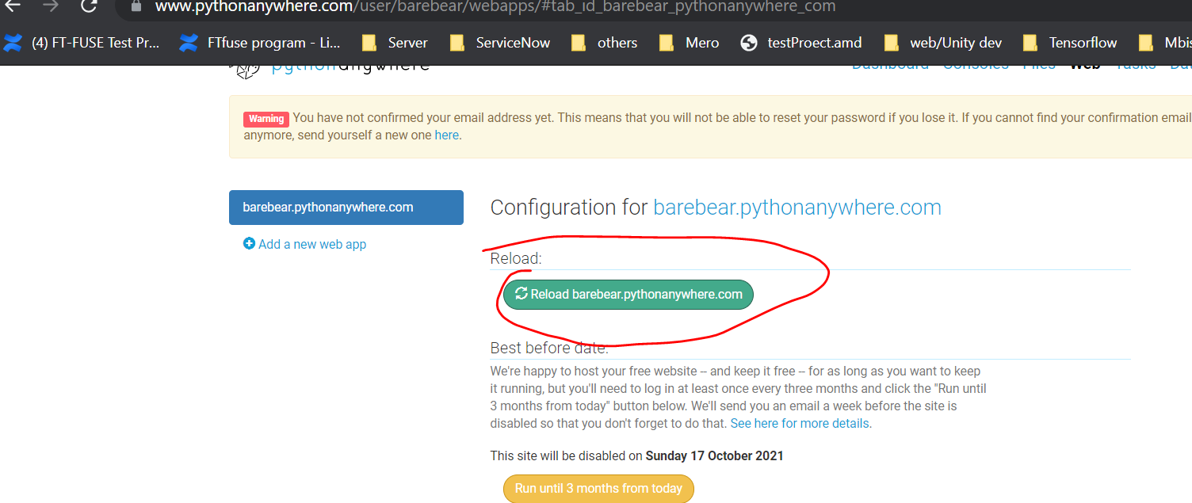
Reload

Slide 8
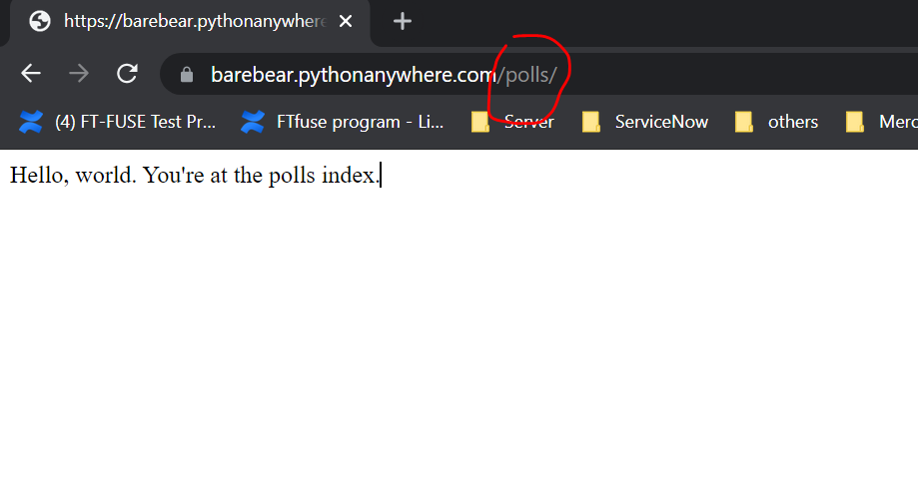
Website been updated

